Slide 1
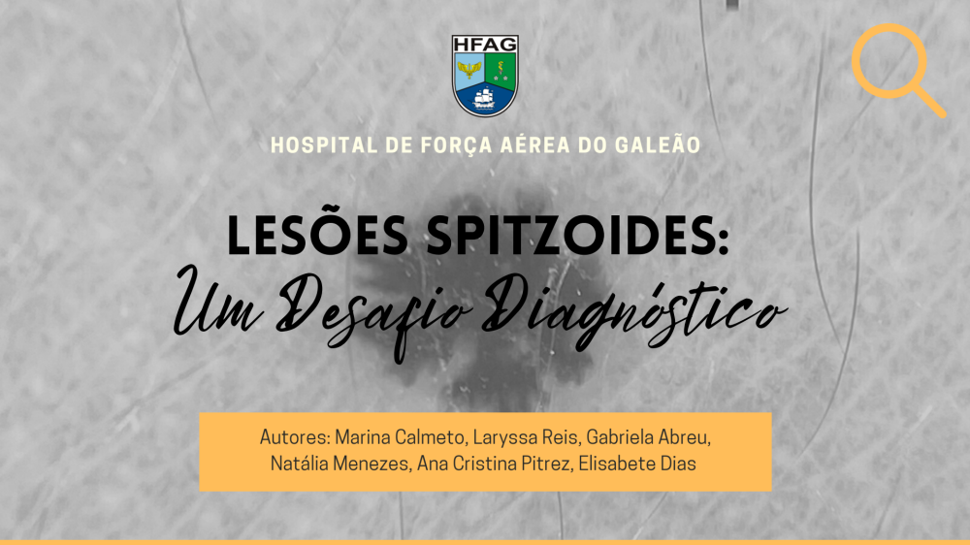
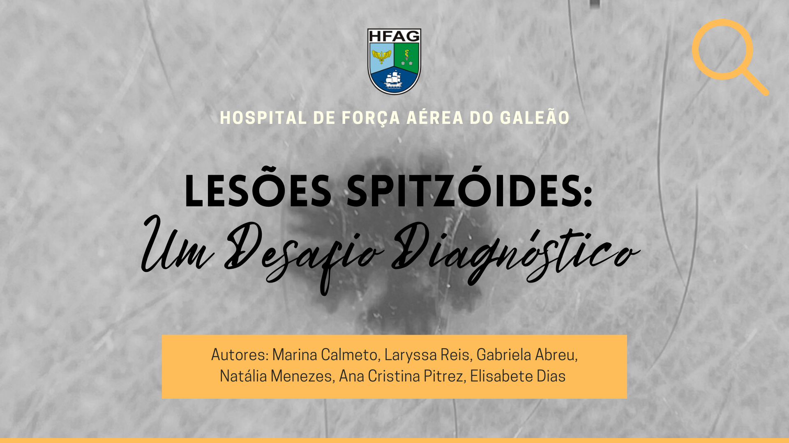

Slide 2
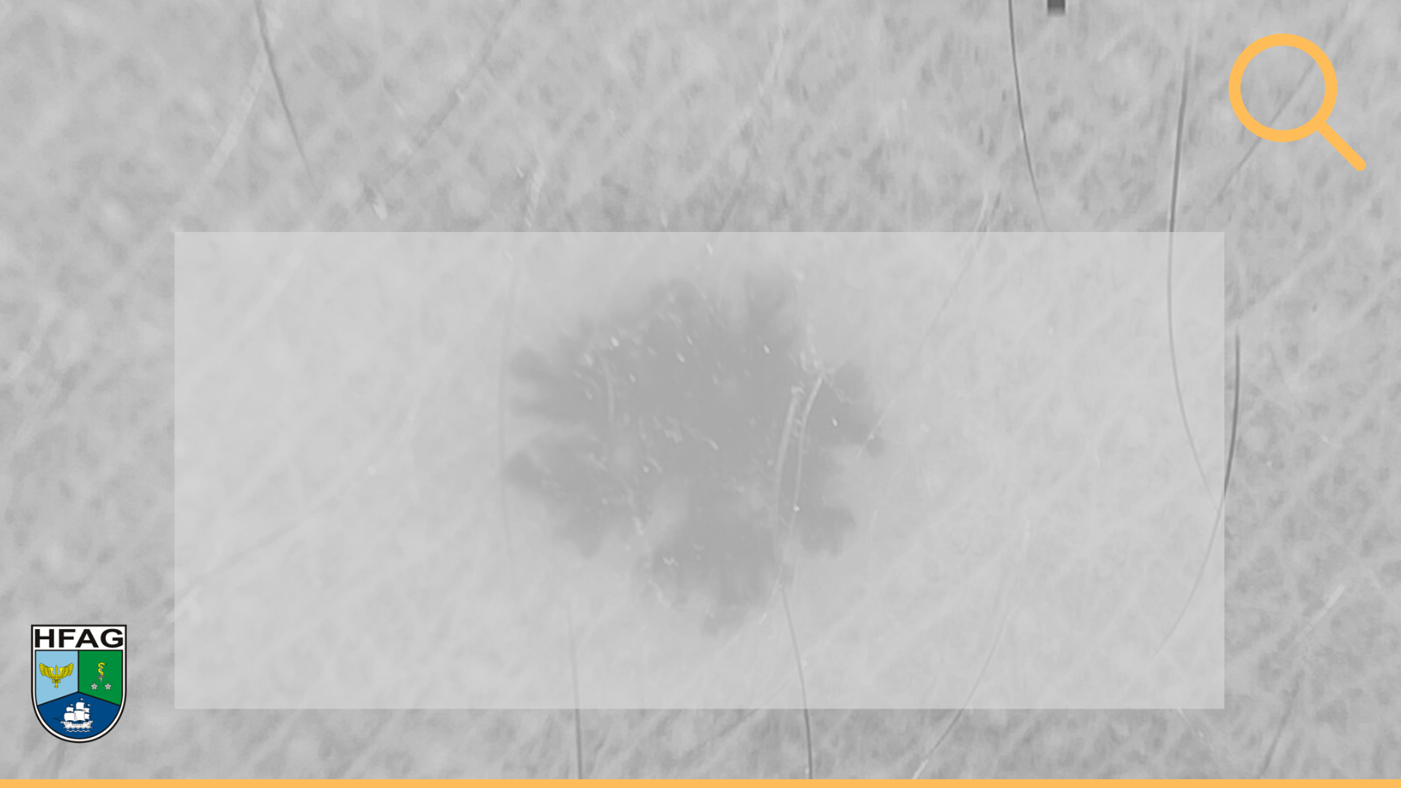
Relato de Caso
HMA: Paciente de 6 anos, masculino, acompanhado da mãe, que refere surgimento de lesão enegrecida em braço esquerdo há dois meses, assintomática, evoluindo com aumento do tamanho.
HPP: Nega comorbidades ou uso de medicamentos. Sem história de câncer ou doenças dermatológicas familiares.
Exame dermatológico: pápula enegrecida de 2 mm em antebraço esquerdo.

Slide 3
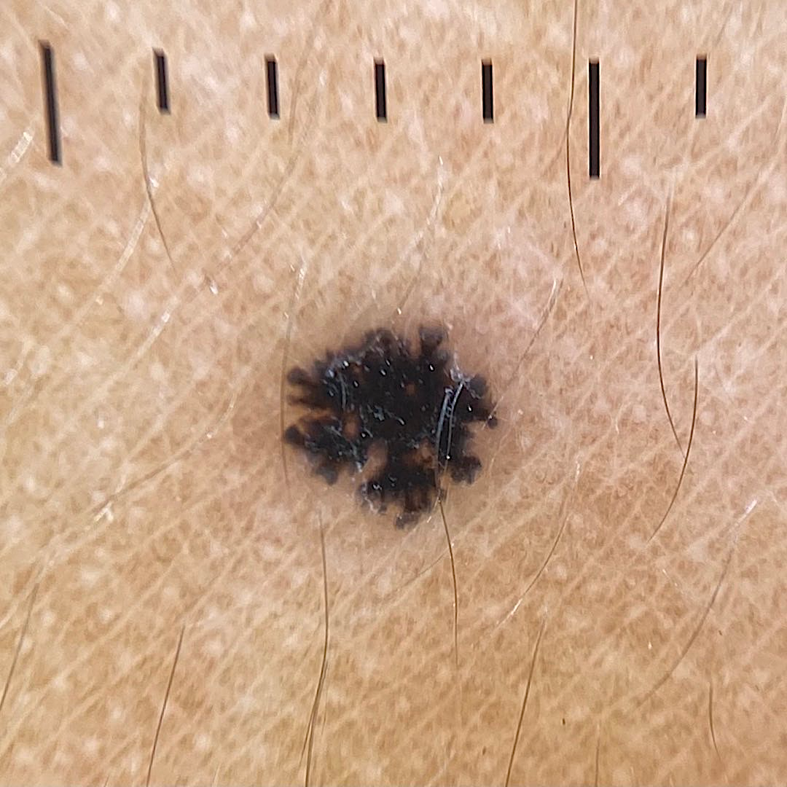
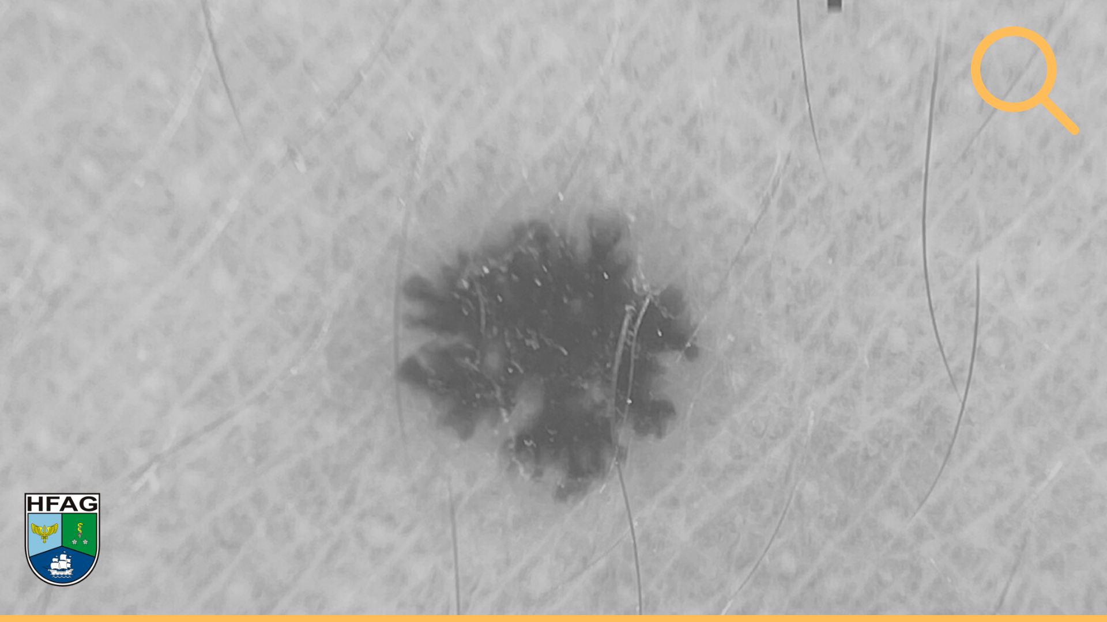

Slide 4


Área homogênea
central
Pseudópodes periféricos
Padrão “starbust”

Slide 5
Hipóteses Diagnósticas
Nevo de Spitz
Melanoma Spitzoide

Slide 6

Conduta
Follow-up?
Excisão da lesão?
Expectante?

Slide 7

Lesões Spitzoides
1948
1989
1995
“Melanoma juvenil”
Sophie Spitz¹
“Nevo de Spitz com atipia
e metástases”
Smith et al.²
“Tumor de Spitz Atípico”
Barnhill³
Nevo de Spitz
Tumor de Spitz Atípico
Melanoma Spitzóide
1 Spitz S. Melanomas of childhood. Am J Pathol 1948; 24:591–609.
2. Smith KJ, Barrett TL, Skelton HG, et al. Spindle cell and epithelioid cell nevi with atypia and metastasis (malignant Spitz nevus). Am J Surg Pathol 1989; 13:931–9.
3. Barnhill RL, Flotte TJ, Fleischli M, et al. Cutaneous melanoma and atypical Spitz tumors in children. Cancer 1995;76:1833–45.
Notes:
After earlier anecdotal reports1,2 the history of these controversial lesions began in 1948 when Sophie Spitz described 13 cases of what she called “juvenile melanoma,” underlining its pre- sumably good prognosis because only one case of her series had proved fatal.3 During the following 40 years, the entity described by Sophie Spitz was thought to be completely benign, with metastasizing cases being intuitively considered as cases of melanomas simulating Spitz nevus (spitzoid melanoma).4 In 1989, Smith and co- workers described the so-called Spitz nevus with atypia and metastasis or malignant Spitz nevus (ie, a kind of Spitz lesion showing histopathologic features insufficient for a diagnosis of malignancy, yet capable of nodal metastasis, usually with no further dissemination).5 This apparently contradic- tory concept was then set forth by Barnhill with the diagnostic category of metastasizing Spitz tumor6 or atypical Spitz nevus/tumor.7 To date, although Ackerman and his fellows maintain that there are only two diagnostic categories (nevus and mela- noma), and that every abnormal behavior is simply a diagnostic mistake,8 others suggest that spitzoid lesions are indeed a morphobiologic spectrum ranging from benignity to full-blown malignancy,9 with the intermediate lesions requiring a diagnostic approach based on different (peculiar) taxonomic and diagnostic criteria.10 As an extreme conse- quence of this view, every spitzoid lesion actually could be intermediate and thereby designated as tumors (without or with atypical features)11: this implies that all spitzoid lesions could be virtually nonbenign and that the new dichotomic approach could be tumor versus melanoma. This article ar- gues against old and new dichotomic diagnostic approaches
--
Since its first description by Sophie Spitz, the morphological and biological spectrum of Spitz naevus has been extensively investigated.1,2 Although initially described as ‘juvenile mela- noma’, the benign nature of Spitz naevus was very soon understood. For several decades, this tumour was considered to be completely benign and cases of metastatic disease were assumed to represent incorrectly diagnosed melanomas mim- icking a Spitz naevus.3
However, in the late 1990s, cases of spitzoid lesions with- out malignant histopathological criteria but with the potential of nodal metastasis were described.4 This observation initiated a new era of controversies on the true biology of spitzoid neoplasms, characterized by the introduction of several terms attempting to classify spitzoid tumours with intermediate histopathological features between Spitz naevus and spitzoid melanoma (Spitz naevus with atypia and metastasis, metasta- sizing Spitz tumour, atypical Spitz tumour, atypical Spitz nae- vus, melanocytic tumour of unknown malignant potential, melanocytoma).5–8 The controversies on terminology, classifi- cation and management strategies of these tumours continue to the present day.

Slide 8
Padrões Dermatoscópicos
Padrão | Definição
Explosão de estrelas | Estrias/pseudopodos radiais com área central homogênea pigmentada
Globular | Glóbulos de vários tamanhos em tons de marrom a preto-acinzentado
Homogêneo | Pigmentação marrom a preto-acinzentado difuso
Reticular | Rede pigmentada cobrindo a maior parte da lesão
Multicomponente* | Mais de um dos padrões descritos
Despigmentação reticular | Rede hipopigmentada/branca circundando estruturas vasculares
Vasos em ponto | Pontos vermelhos difusos
Vasos Glomerulares | Capilares tortuosos em forma de glomérulo, difusos
Vasos em grampo | Vasos curvados
Vasos lineares irregulares | Vasos lineares irregulares
Lallas A, Apalla Z, Ioannides D, Lazaridou E, Kyrgidis A, Broganelli P, Alfano R, Zalaudek I, Argenziano G; International Dermoscopy Society. Update on dermoscopy of Spitz/Reed naevi and management guidelines by the International Dermoscopy Society. Br J Dermatol. 2017 Sep;177(3):645-655. doi: 10.1111/bjd.15339. Epub 2017 Jul 19. PMID: 28118479.
Notes:
The introduction of dermoscopy significantly improved the clinical recognition of Spitz naevi, as they were shown to exhibit a peculiar and characteristic pattern of dermoscopic structures.9
For dermoscopic patterns of pigmented Spitz (Reed) naevus, our results show that the vast majority are dermoscopically typified either by a starburst or by a globular pattern, the lat- ter usually associated with reticular depigmentation (Figs 1 and 2), sendo altamente sugestivos de nevo de spitz
It must be mentioned that a globular pattern not asso- ciated with reticular depigmentation cannot be considered as specific for Spitz naevus, as it is well known that the majority of naevi, especially in children, display a pattern of globules
Spitz naevi with a different dermoscopic aspect do exist (homogeneous, reticular, multicomponent). The homoge- neous and reticular patterns have been suggested to represent later evolution phases of the starburst pattern. In any case, the latter patterns cannot be considered as specific for spitzoid tumours, as they can be found much more frequently in other naevus types, while the multicomponent pattern, as discussed above, should be considered as suggestive of melanoma.
With regard to nonpigmented Spitz naevus, regularly dis- tributed dotted vessels represent the dermoscopic hallmark.

Slide 9
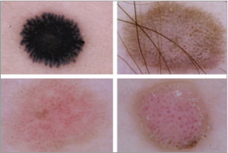
Padrões Dermatoscópicos
Starbust
Despigmentação reticular
Vasos em ponto
Vasos glomerulares
Lallas A, Apalla Z, Ioannides D, Lazaridou E, Kyrgidis A, Broganelli P, Alfano R, Zalaudek I, Argenziano G; International Dermoscopy Society. Update on dermoscopy of Spitz/Reed naevi and management guidelines by the International Dermoscopy Society. Br J Dermatol. 2017 Sep;177(3):645-655. doi: 10.1111/bjd.15339. Epub 2017 Jul 19. PMID: 28118479.
Notes:
Fig 4. The four patterns that can be considered as suggestive of a Spitz naevus: starburst (a); globular with reticular depigmentation (b); dotted vessels with inverse network corresponding to a flat lesion (c); and globular/coiled vessels with inverse network corresponding to a nodule (d).
650 Dermoscopic morphology of Spitz naevi and management guidelines, A. Lallas et al.

Slide 10
Melanoma spitzoide
Dermatoscopia:
  Assimetria
  Padrão multicomponentes
  Nevo de Spitz-símile ⚠️
Risco de melanoma nas lesões spitzoides¹
  > 50 anos – 50% de probabilidade
  < 30 anos – 7% de probabilidade
  Lesões nodulares – 32% de probabilidade
  Lesões planas – 12% de probabilidade
1. Lallas A, Apalla Z, Ioannides D, Lazaridou E, Kyrgidis A, Broganelli P, Alfano R, Zalaudek I, Argenziano G; International Dermoscopy Society. Update on dermoscopy of Spitz/Reed naevi and management guidelines by the International Dermoscopy Society. Br J Dermatol. 2017 Sep;177(3):645-655. doi: 10.1111/bjd.15339. Epub 2017 Jul 19. PMID: 28118479.
Notes:
For spitzoid melanoma, the dermoscopic morphology usually follows the basic rule of asymmetry: it is typically charac- terized by an asymmetric distribution of spitzoid features (streaks, globules, vascular structures), often combined among them to form the so-called multicomponent pattern. However, less frequently, melanoma might perfectly mimic a pigmented or nonpigmented Spitz naevus
This was demon- strated by a recent study evaluating 384 dermoscopically sym- metric spitzoid-looking lesions in patients greater than 12 years of age.
This was demon- strated by a recent study evaluating 384 dermoscopically sym- metric spitzoid-looking lesions in patients greater than 12 years of age.
his was demon- strated by a recent study evaluating 384 dermoscopically sym- metric spitzoid-looking lesions in patients greater than 12 years of age.18 Approximately 13% of these tumours were proven to be melanomas, with the probability of melanoma increasing significantly with age. For example, a perfectly symmetric spitzoid-looking lesion developing in an individual after the age of 50 years is associated with a 50% probability of being melanoma, whereas this probability decreases to 7% for patients less than 30 years of age. Nodular spitzoid lesions are associated with a higher possibility of melanoma (32%), but also the risk of flat lesions remains considerable (12%).
. In the light of the latter significant morphological overlap between Spitz naevus and melanoma, the management of spit- zoid tumours should be adjusted accordingly, as discussed below.
Lallas A, Moscarella E, Longo C et al. Likelihood of finding mela- noma when removing a Spitzoid-looking lesion in patients aged 12 years or older. J Am Acad Dermatol 2015; 72:47–53.

Slide 11
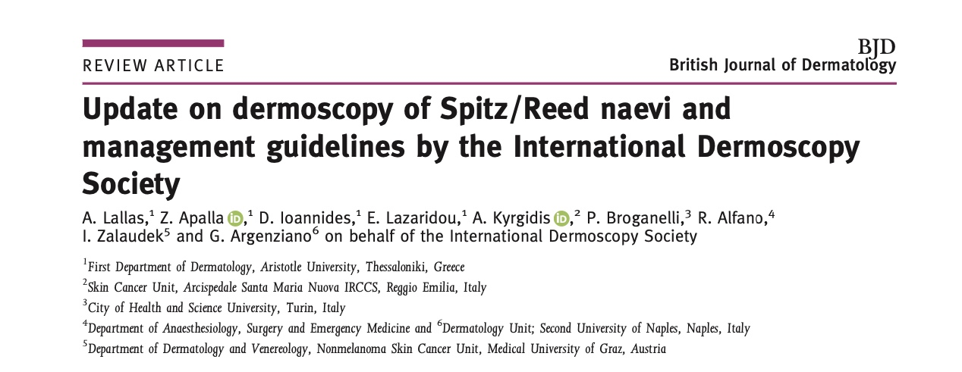
Manejo
Notes:
These recommendations are based on the notion that the dual goal of our clinical practice is to min- imize the risk of missing melanoma and avoid, as much as possible, unnecessary excisions of benign moles.32 The safest strategy would be to excise any lesion with spitzoid features (symmetrically or asymmetrically distributed) irrespectively of the age of the patient. Obviously, this strategy is associated with no risk of missing melanoma, but will also result in a relatively high number of excisions of benign moles.

Slide 12
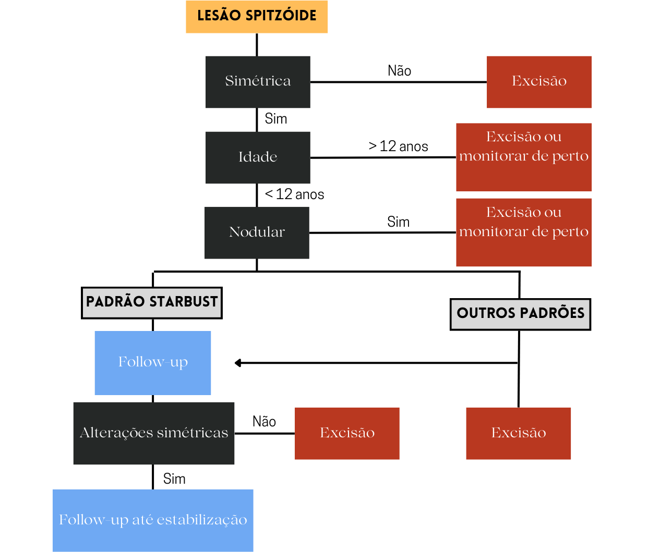
*
* Planas:
A cada 2-3 meses →
Encerrar após 6 meses
sem crescimento ou
involução completa
**
**
** Nodulares:
15/15 dias por 1 mês →
Mensal → Bimestral →
Encerrar após 6 meses
sem crescimento ou
involução completa
Adaptado de: Lallas A, Apalla Z, Ioannides D, Lazaridou E, Kyrgidis A, Broganelli P, Alfano R, Zalaudek I, Argenziano G; International Dermoscopy Society. Update on dermoscopy of Spitz/Reed naevi and management guidelines by the International Dermoscopy Society. Br J Dermatol. 2017 Sep;177(3):645-655. doi: 10.1111/bjd.15339. Epub 2017 Jul 19. PMID: 28118479.

Slide 13
Passo 1:
Simetria
*
* Planas:
A cada 2-3 meses →
Encerrar após 6 meses
sem crescimento ou
involução completa
**
**
** Nodulares:
15/15 dias por 1 mês →
Mensal → Bimestral →
Encerrar após 6 meses
sem crescimento ou
involução completa
Adaptado de: Lallas A, Apalla Z, Ioannides D, Lazaridou E, Kyrgidis A, Broganelli P, Alfano R, Zalaudek I, Argenziano G; International Dermoscopy Society. Update on dermoscopy of Spitz/Reed naevi and management guidelines by the International Dermoscopy Society. Br J Dermatol. 2017 Sep;177(3):645-655. doi: 10.1111/bjd.15339. Epub 2017 Jul 19. PMID: 28118479.

Slide 14
Passo 1:
Simetria
Passo 2:
Idade
*
* Planas:
A cada 2-3 meses →
Encerrar após 6 meses
sem crescimento ou
involução completa
**
**
** Nodulares:
15/15 dias por 1 mês →
Mensal → Bimestral →
Encerrar após 6 meses
sem crescimento ou
involução completa
Adaptado de: Lallas A, Apalla Z, Ioannides D, Lazaridou E, Kyrgidis A, Broganelli P, Alfano R, Zalaudek I, Argenziano G; International Dermoscopy Society. Update on dermoscopy of Spitz/Reed naevi and management guidelines by the International Dermoscopy Society. Br J Dermatol. 2017 Sep;177(3):645-655. doi: 10.1111/bjd.15339. Epub 2017 Jul 19. PMID: 28118479.

Slide 15

Passo 1:
Simetria
Passo 2:
Idade
*
* Planas:
A cada 2-3 meses →
Encerrar após 6 meses
sem crescimento ou
involução completa
**
Passo 3:
Clínica
**
** Nodulares:
15/15 dias por 1 mês →
Mensal → Bimestral →
Encerrar após 6 meses
sem crescimento ou
involução completa
Adaptado de: Lallas A, Apalla Z, Ioannides D, Lazaridou E, Kyrgidis A, Broganelli P, Alfano R, Zalaudek I, Argenziano G; International Dermoscopy Society. Update on dermoscopy of Spitz/Reed naevi and management guidelines by the International Dermoscopy Society. Br J Dermatol. 2017 Sep;177(3):645-655. doi: 10.1111/bjd.15339. Epub 2017 Jul 19. PMID: 28118479.

Slide 16
Condução
Nevo de Spitz
  Sem tratamento adicional necessário
Melanoma Spitzoide
  Manejo semelhante aos outros tipos de melanoma
Tumor de Spitz Atípico
  Excisão cirúrgica ampla (margem de 1cm) + follow-up clínico de linfonodos superficiais por 3 anos
Lallas A, Apalla Z, Ioannides D, Lazaridou E, Kyrgidis A, Broganelli P, Alfano R, Zalaudek I, Argenziano G; International Dermoscopy Society. Update on dermoscopy of Spitz/Reed naevi and management guidelines by the International Dermoscopy Society. Br J Dermatol. 2017 Sep;177(3):645-655. doi: 10.1111/bjd.15339. Epub 2017 Jul 19. PMID: 28118479.
Notes:
For histopathologically ambiguous spitzoid tumours, the spectrum of spitzoid lesions ranges between Spitz naevus, which represents a benign tumour with no difference in prog- nosis compared with other types of naevi, and spitzoid mela- noma. Subsequently, in the hypothetical scenario that all Spitz naevi and all spitzoid melanomas could be accurately diag- nosed as such, the optimal management of naevi would require no action, whereas spitzoid melanoma should be man- aged as any other melanoma type.
The controversy arises from the fact that between these two extremes are tumours that cannot be safely diagnosed histopathologically either as naevi or as melanomas. This is because their histopathological alterations extend beyond the expected atypia of Spitz naevi but without fulfilling the crite- ria of melanoma.
Among the several terms that histopatholo- gists have used to classify these tumours, ‘atypical Spitz tumour’ (AST) has been more globally adopted.33
The fact that AST represents an intermediate entity in terms of histopathological morphology does not necessarily equate to an intermediate biological course. Sentinel lymph node biopsy (SLNB) has been suggested as a possible solution to this diag- nostic problem, based on the assumption that detection of melanocytic cells in the SLN could predict aggressive biologi- cal behaviour.34 However, recent meta-analytic data including all published cases worldwide demonstrated that AST is asso- ciated with a highly favourable prognosis, even in cases of SLNB positivity.35 Accordingly, evidence suggests that the optimal management of AST is wide surgical excision, while SLNB should be considered inappropriate. Although data sug- gesting optimal margins for wide local excision are lacking, the most frequently used margins are 1 cm, which is also our suggestion. Clinical follow-up with superficial node palpation is recommended at least once per year for 3 years. Work-up with ultrasound is required in case of palpable nodes or doubt.

Slide 17
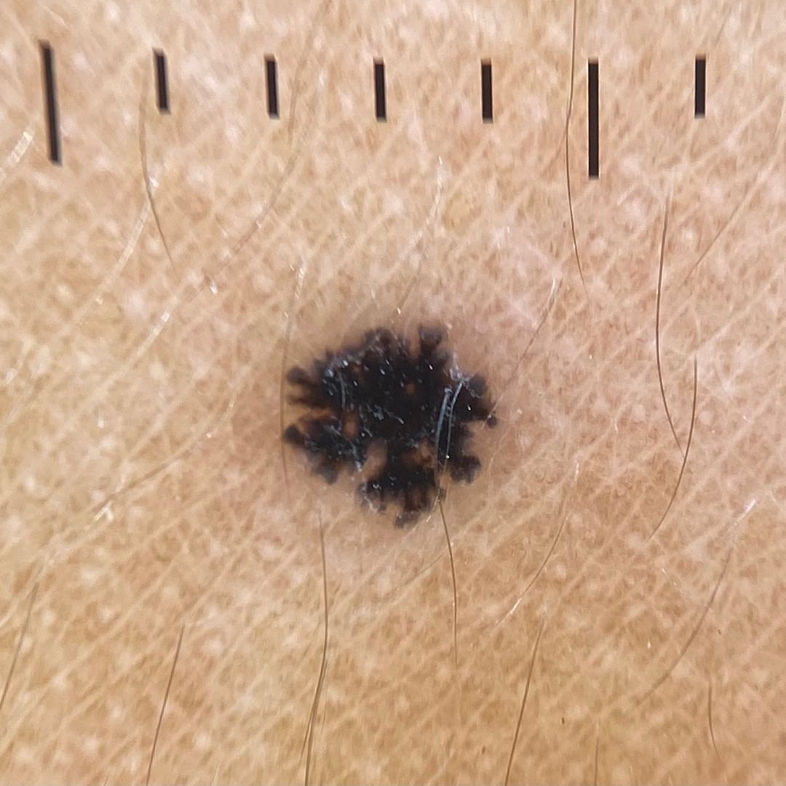
Voltando ao caso...
6 anos
Pápula enegrecida em braço esquerdo
Padrão starbust simétrico
Excisão cirúrgica

Slide 18
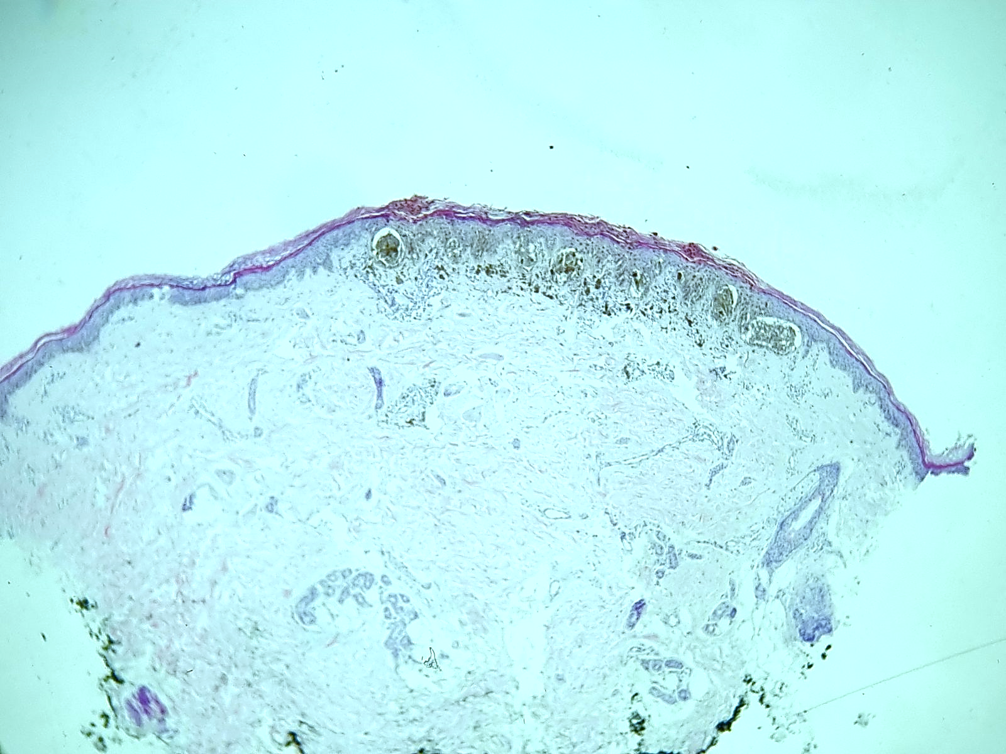
Exame
Histopatológico
Lesão simétrica e bem circunscrita

Slide 19
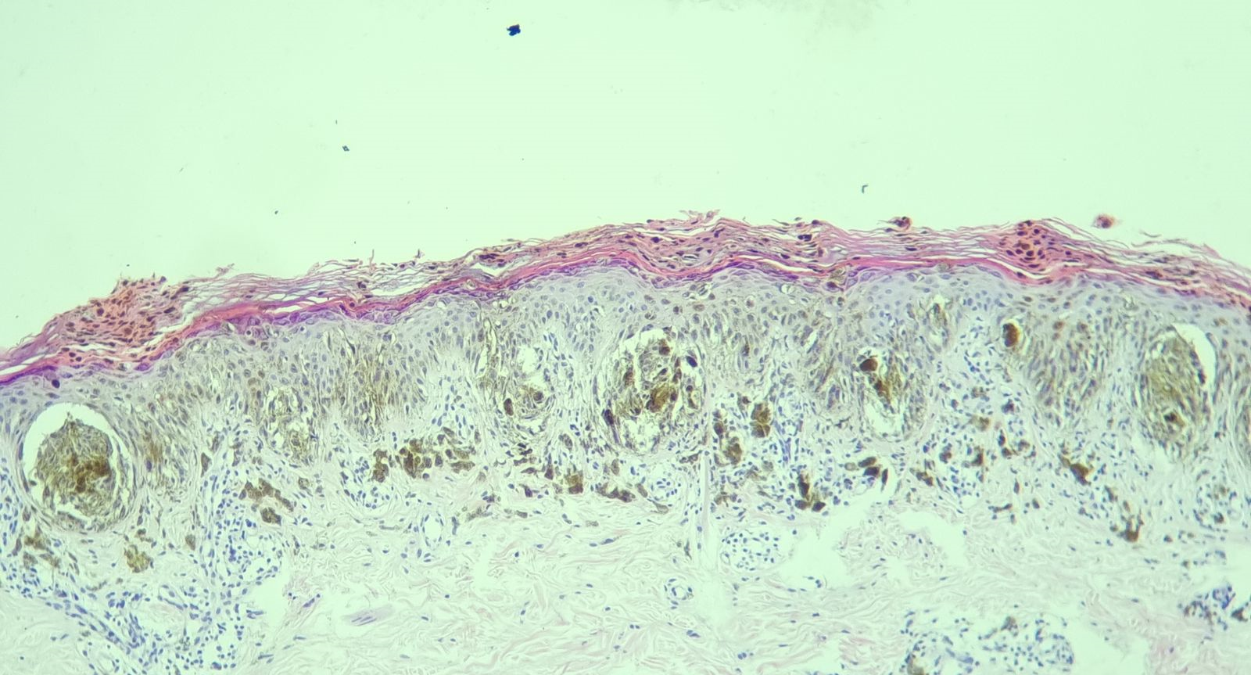

Slide 20
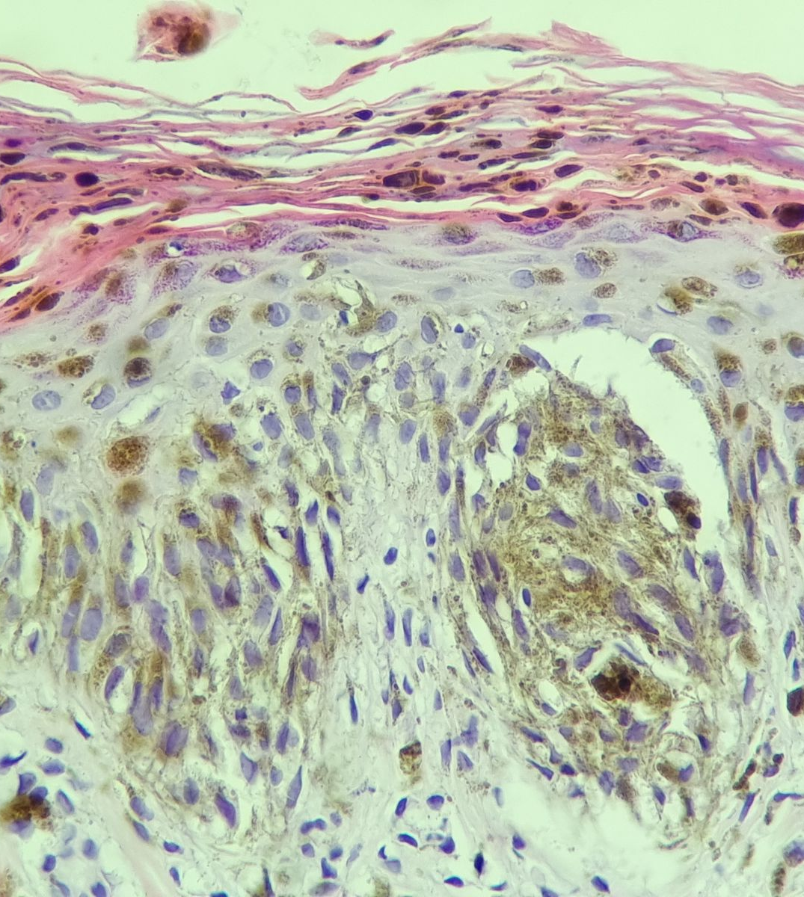

Slide 21
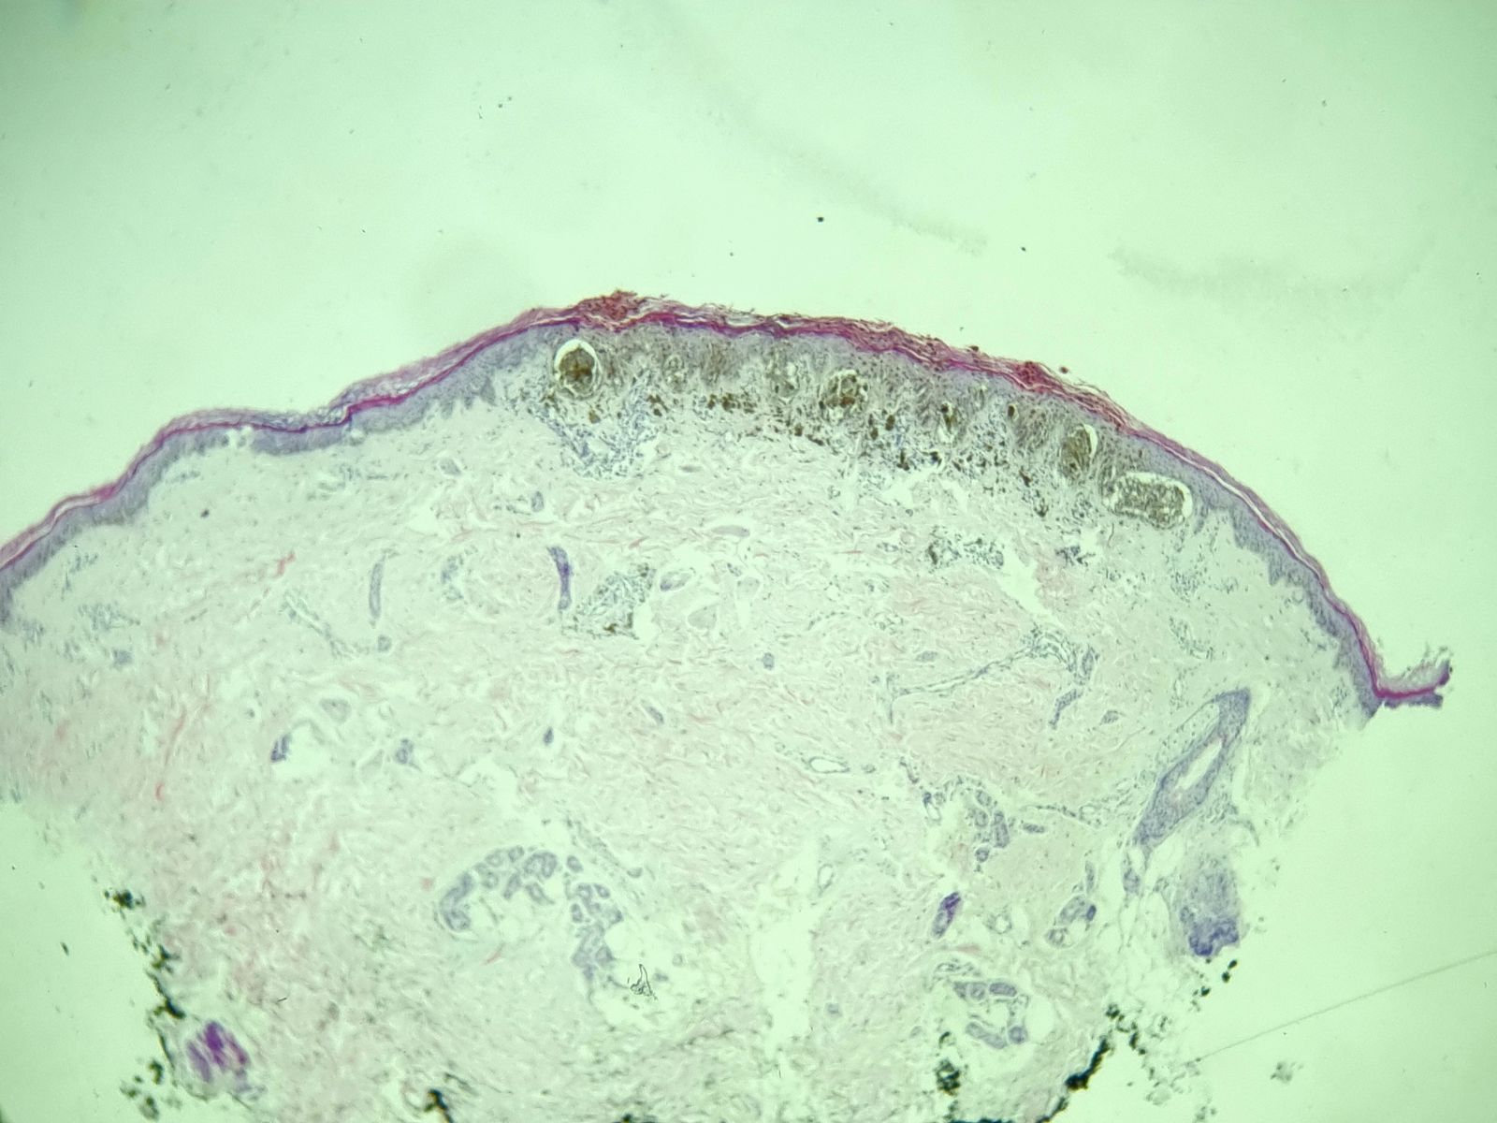
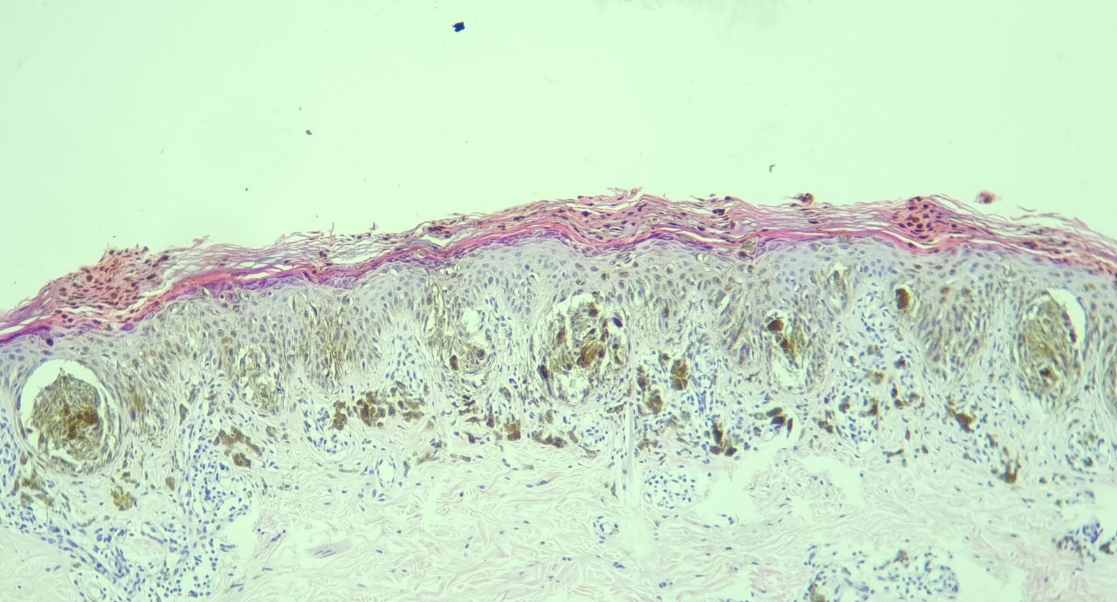
Exame
Histopatológico
Nevo melanocítico juncional de células fusiformes pigmentado
Imagens cedidas pelo Dr. Daniel Obadia

Slide 22
Motivos da Apresentação
Apresentar um caso de lesão melanocítica frequente na população pediátrica com manejo desafiador devido risco de malignidade
Realizar um update da classificação dermatoscópica das Lesões Spitzoides baseado em revisão da literatura
Prover recomendações de manejo dessas lesões de acordo com seu caráter clínico e morfológico na dermatoscopia e histopatologia.

Slide 23
Agradecimentos
Lidiane Marques
Fernando Alves
Thais Martins
Paula Farias
Daniel Obadia

Slide 24
Referências
Ferrara, Gerardo; Gianotti, Raffaele; Cavicchini, Stefano; Salviato, Tiziana; Zalaudek, Iris; Argenziano, Giuseppe (2013). Spitz Nevus, Spitz Tumor, and Spitzoid Melanoma. Dermatologic Clinics, 31(4), 589–598.
Spitz S. Melanomas of childhood. Am J Pathol 1948; 24:591–609.
Smith KJ, Barrett TL, Skelton HG, et al. Spindle cell and epithelioid cell nevi with atypia and metastasis (malignant Spitz nevus). Am J Surg Pathol 1989; 13:931–9.
Barnhill RL, Flotte TJ, Fleischli M, et al. Cutaneous melanoma and atypical Spitz tumors in children. Cancer 1995;76:1833–45.
Lallas A, Apalla Z, Ioannides D, Lazaridou E, Kyrgidis A, Broganelli P, Alfano R, Zalaudek I, Argenziano G; International Dermoscopy Society. Update on dermoscopy of Spitz/Reed naevi and management guidelines by the International Dermoscopy Society. Br J Dermatol. 2017 Sep;177(3):645-655.
Bär, Michael; Tschandl, Philipp; Kittler, Harald (2012). Differentiation of pigmented Spitz nevi and Reed nevi by integration of dermatopathologic and dermatoscopic findings. Dermatology Practical & Conceptual, 2(1), –.
Pedrosa, Ana; Lopes, Jose; Azevedo, Filomena; Mota, Alberto (2016). Spitz/Reed nevi: a review of clinical-dermatoscopic and histological correlation. Dermatology Practical & Conceptual, 6(2), –.
Kerner, Miryam; Jaimes, Natalia; Scope, Alon; Marghoob, Ashfaq A. (2013). Spitz Nevi. Dermatologic Clinics, 31(2), 327–335.

Slide 25
Obrigada
marina.calmeto@live.com
@dermo.scopy

